Slide 1

Creating the Hunt Partners App: Cross-Departmental Rapid Response
Charlie Morris
Bret Davidson

Slide 2
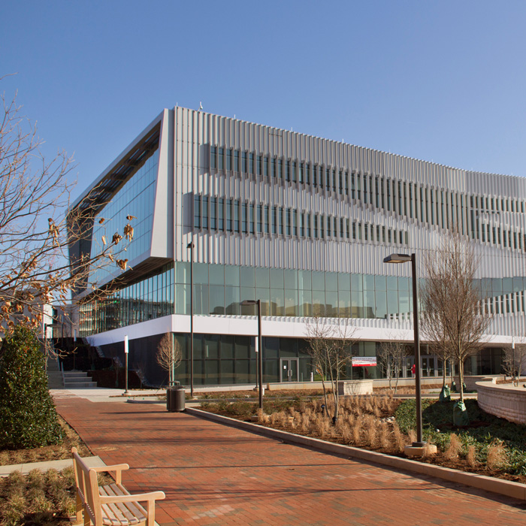

Slide 3
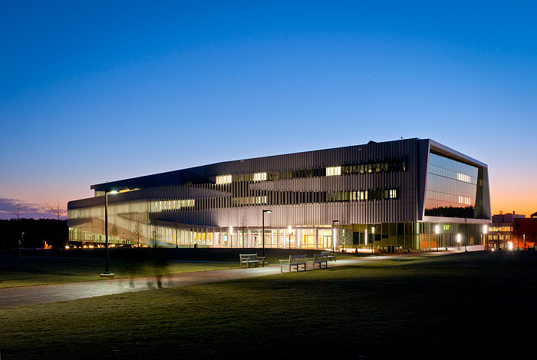

Slide 4
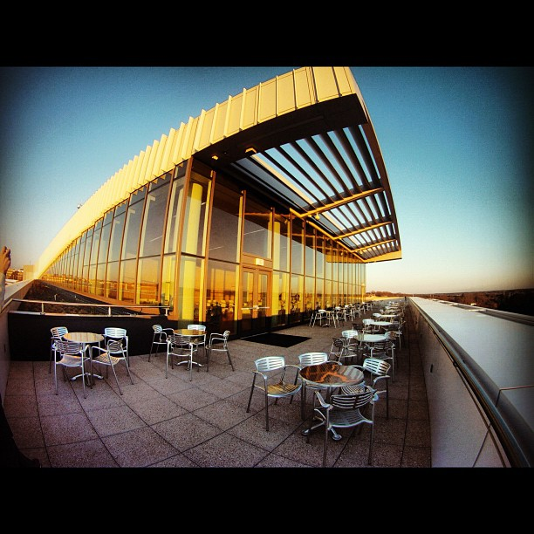

Slide 5


Slide 6


Slide 7
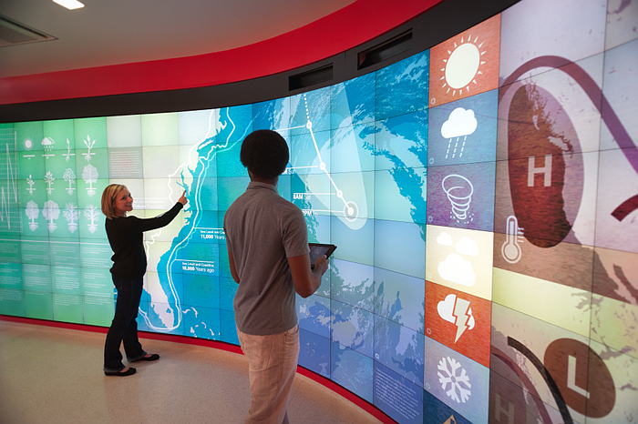

Slide 8
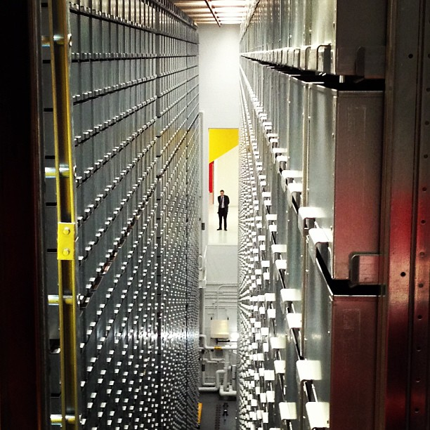

Slide 9
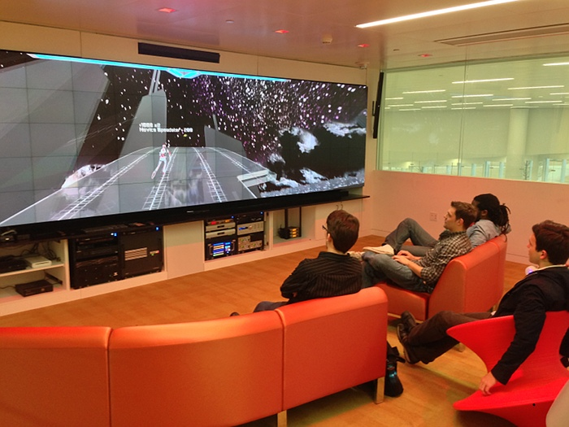

Slide 10


Slide 11
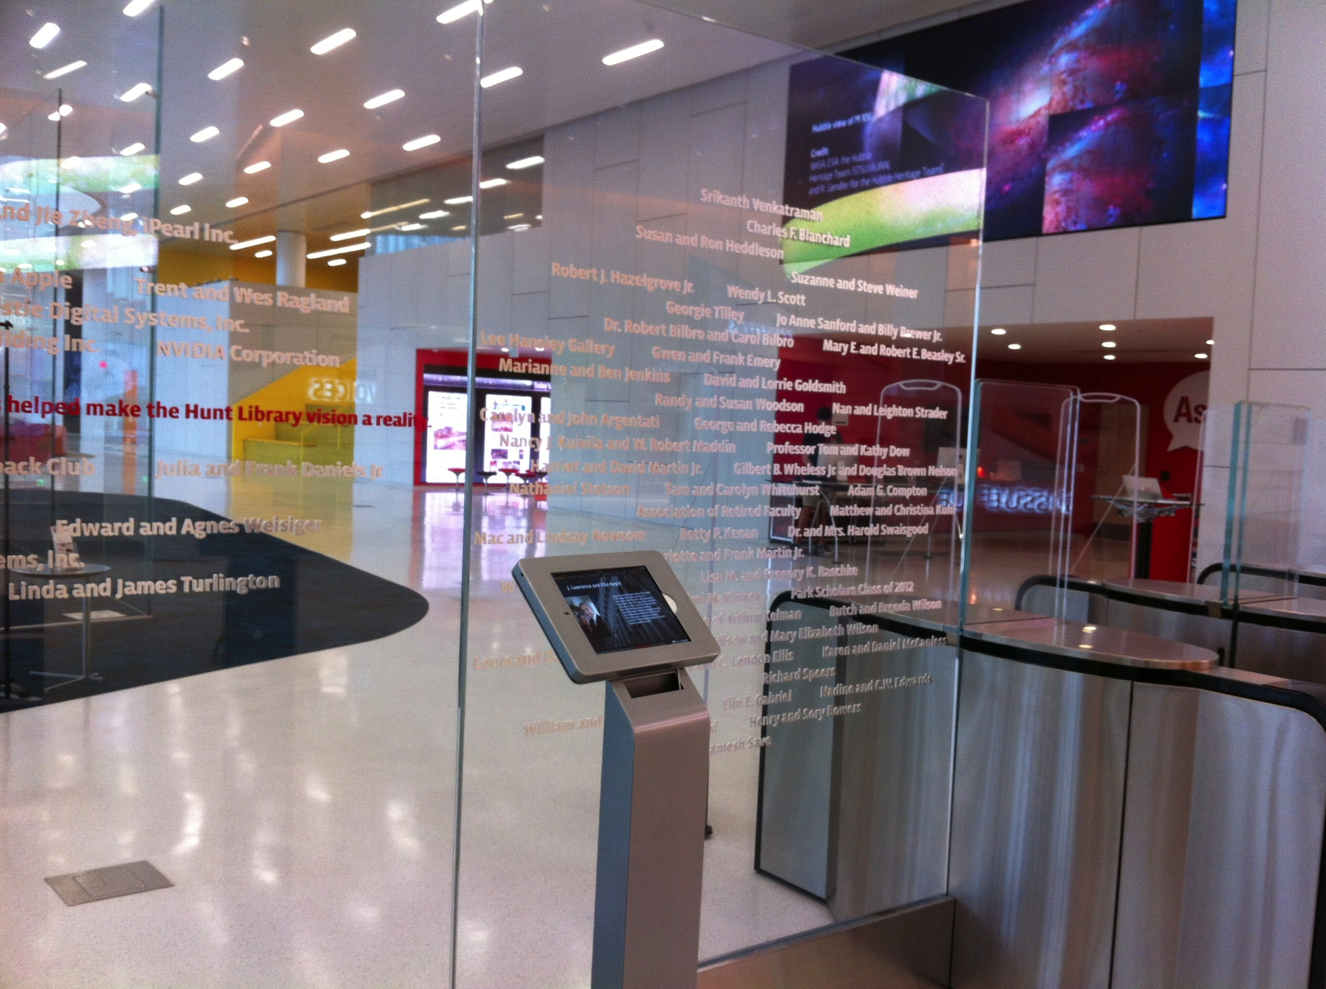

Slide 12
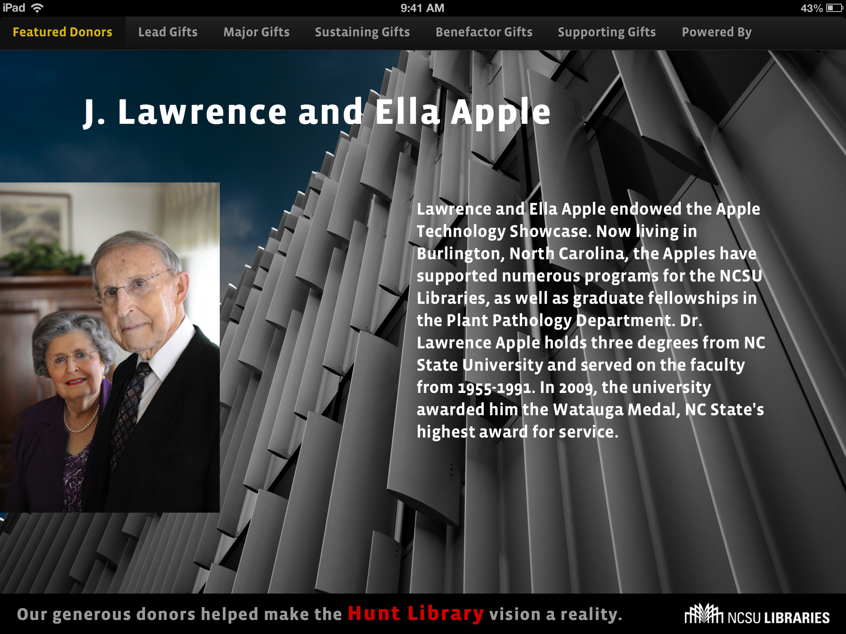

Slide 13
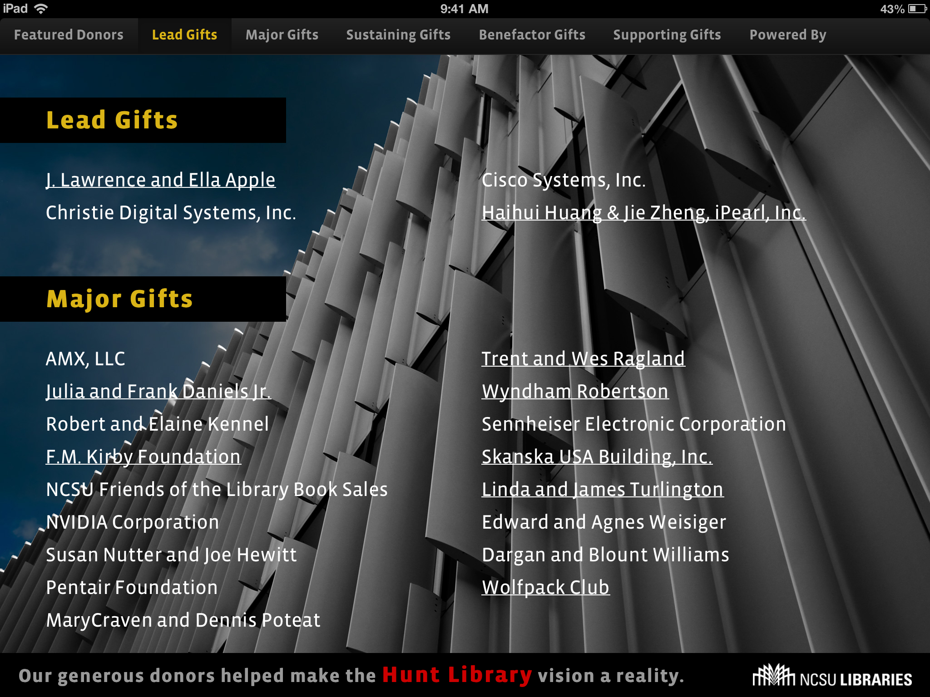

Slide 14
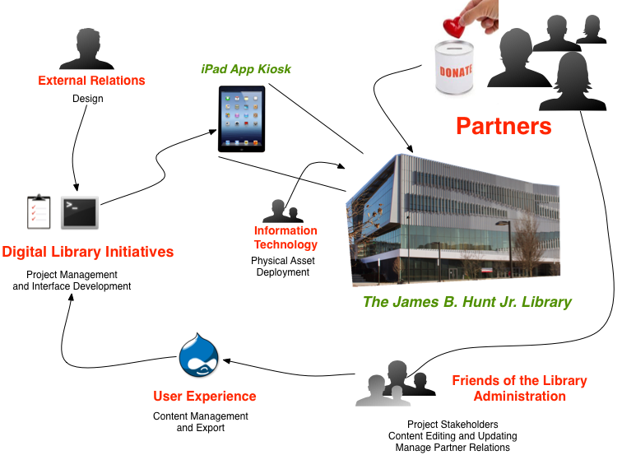
Notes:
stepping back, the rich picture diagram gives a good sense of all the moving parts
6 departments
Over 800 donors
Arrows on screen show the general workflow, but communication was multi-directional and this is over-simplification
Walking through process:
FOL/Admin facilitate relationship with donors
DLI manages the project and establishes roles
UE provides the content management backend and data export to
DLI who does, in addition to proj. mgmt, the interface programming
DLI gets design input from the External Relations department
IT procures and establishes the physical assets that DLI programs.
Partners and others can now view the Libraries partners kiosk

Slide 15

Rapid Response Force
For getting something done quickly.
Notes:
Rapid Response Force enablers:
Very tight timeline
Limited scope/Straightforward constraints
High level of certainty of project support
Many team members working on other projects (e.g., Hunt)
“The time we usually take to define and develop shared understating of project goals and state completely overlapped with production-level development and testing”

Slide 16
Keys to Success of Rapid Response Force
Aim for Minimum Viable Product

Slide 17
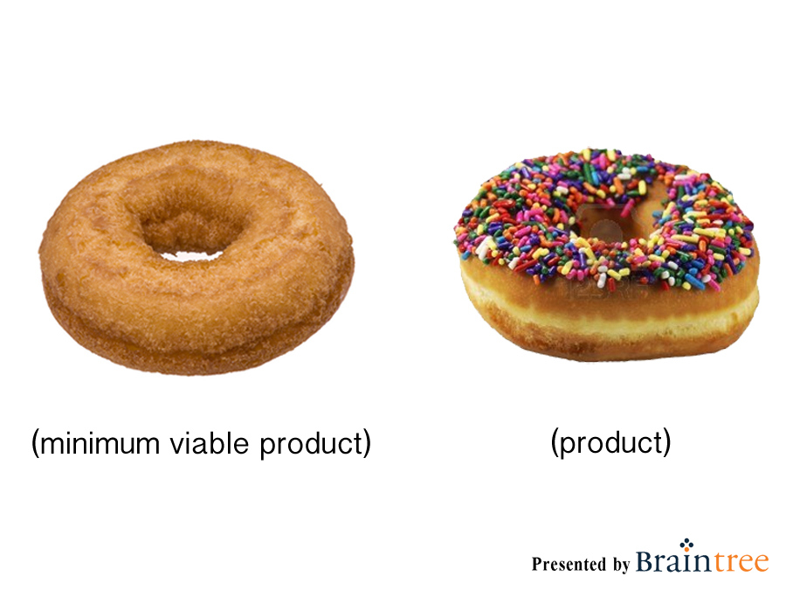
Notes:
Perfect is the enemy of good
Don’t’ wait for the perfect solution. Decide and move forward.
Early success encourages future collaboration.

Slide 18
Keys to Success of Rapid Response Force
Aim for Minimum Viable Product
Leverage Existing Workflows and Technical Resources

Slide 19



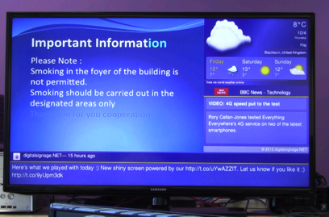

Drupal at NCSU Libraries
Web pages
Apps
Web services module allows RESTful output in multiple formats with or without authentication.
Eboards
Email
Notes:
(slide 1 of 2 for leveraging existing resources)
Breaking down UE’s role in the project:
Part of a greater mission to “create once and publish everywhere” or COPE (nod to NPR), make content manageable and sustainable
Drupal as a the centerpiece of achieving this mission
Drupal’s ability to provide content editing environment and web services for simple data export
Speeds collaboration and overall project completion

Slide 20
Keys to Success of Rapid Response Force
Aim for Minimum Viable Product
Leverage Existing Workflows and Technical Resources
Clear Roles and Responsibilities

Slide 21

Clear Roles and Responsibilities
“Many hands make light work”
Photo: http://arbroath.blogspot.com/2011/11/many-hands-make-light-work.html
Notes:
Different departments have different strengths
Despite how widespread the responsibilities, it never felt overbearing
No one was trying to do too much
At least 6 departments
At least 20 people

Slide 22
Keys to Success of Rapid Response Force
Aim for Minimum Viable Product
Leverage Existing Workflows and Technical Resources
Clear Roles and Responsibilities
Simultaneous Development Cycles

Slide 23

Charlie dev cycles
Notes:
Working in parallel
There were several mini-working groups all iterating at the same time

Slide 24
Keys to Success of Rapid Response Force
Aim for Minimum Viable Product
Leverage Existing Workflows and Technical Resources
Clear Roles and Responsibilities
Simultaneous Development Cycles
Project Appropriate Tools

Slide 25

“Just Enough” Project Management
Notes:
Tools that fit your workflow
Facilitate async collaboration
Overview of project state
Just enough project management

Slide 26
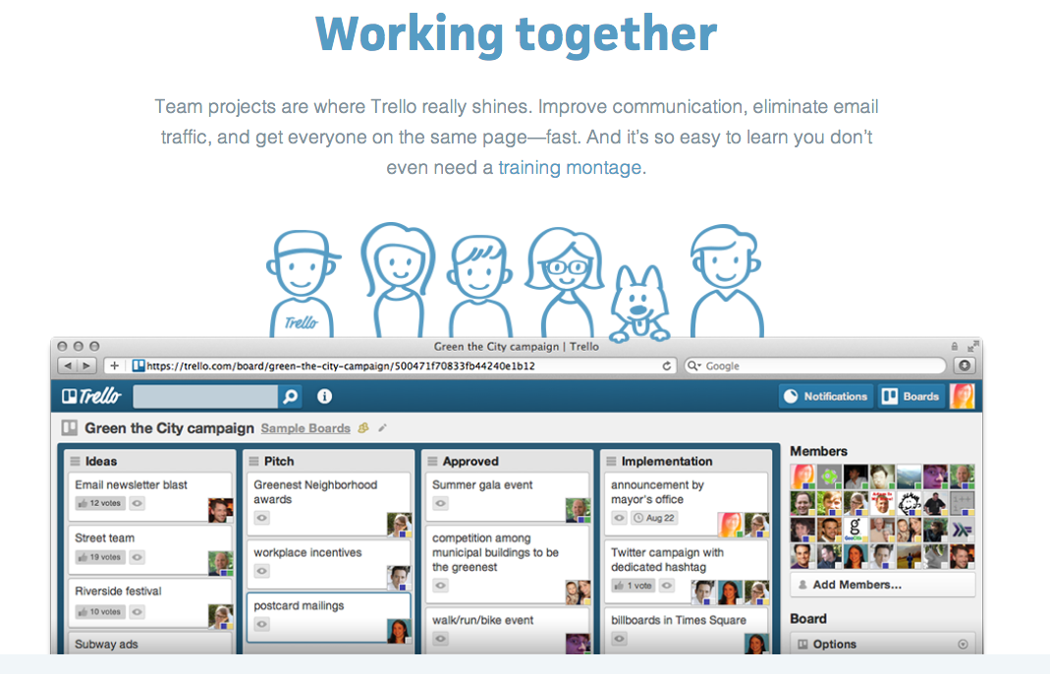

Slide 27
Keys to Success of Rapid Response Force
Aim for Minimum Viable Product
Leverage Existing Workflows and Technical Resources
Clear Roles and Responsibilities
Simultaneous Development Cycles
Project Appropriate Tools
Relationships

Slide 28

Image: http://www.flickr.com/photos/aidan_jones/3575000735/
Notes:
Relationships

Slide 29
Credits
The Rapid Response Team members:
Brent Brafford
Jan Brock
Jason Casden
Lauren Goodwin
Cory Lown
Greg Raschke
Molly Renda

Slide 30
Thank You!
Charlie Morris, Web Development Librarian
charlie_morris@ncsu.edu
Bret Davidson, Digital Technologies Development Librarian
bret_davidson@ncsu.edu

